Slide 1
Genomic variants Bioinformatics Applications (PLPTH813)
Sanzhen Liu
2/27/2025

Slide 2
Outline
Overview of genomic variants
Data for variant discovery
Bioinformatics of variant discovery
Annotation of genomic variants

Slide 3
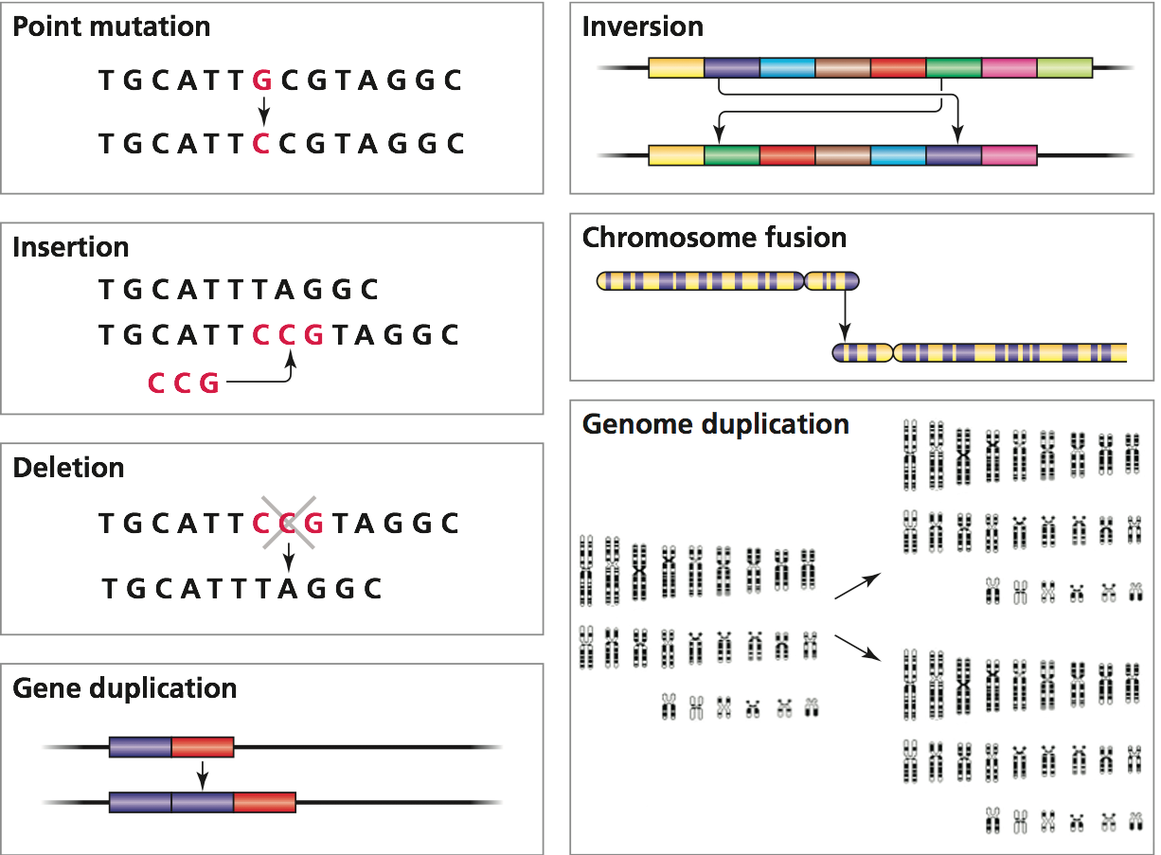
Genomic variants (ploymorphisms)
1. SNP
2. INDEL
3. genomic structural variation
copy number variation, including
presence/absence variation
other re-arrangements
4. Chromosomal alternations

Slide 4
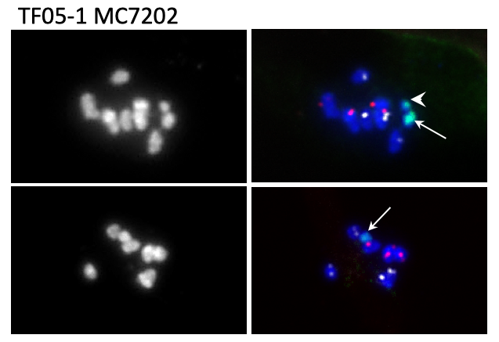
Various numbers of chromosomes from different cells

Slide 5
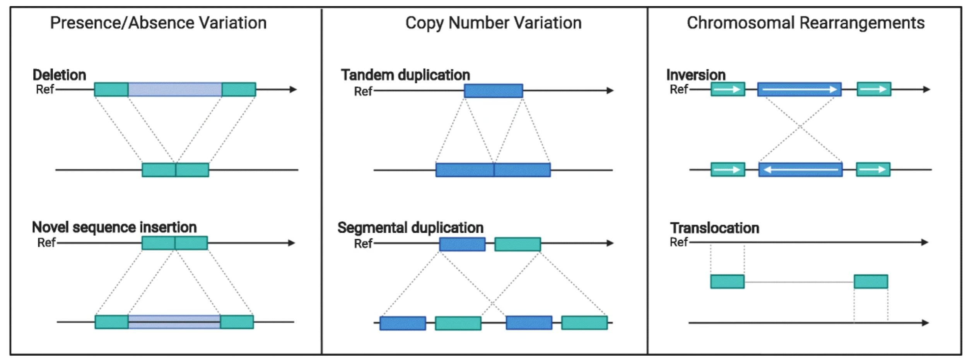
Intra-species genome rearrangements and structural variation (SV)
Variation of 50 bp to several Mb in size
Balanced SV - Inversion, translocation
Unbalanced SV:
- Copy number variation (CNV), Presence/Absence variation (PAV)
Inversion&translocation
Coletta et al., Genome Biol, 2021

Slide 6
Genomic variants - SNPs
SNP stands for single nucleotide polymorphism.
At the population level, frequencies of SNPs are depended on species. For example, millions of SNPs have been discovered in human populations.
Most SNPs are bi-allelic. (mutation rate per site is about 10⁻⁸)
Most SNPs have no or marginal impacts but some could have important phenotypic consequences.

Slide 7
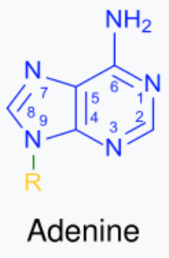
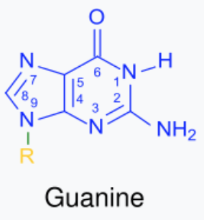
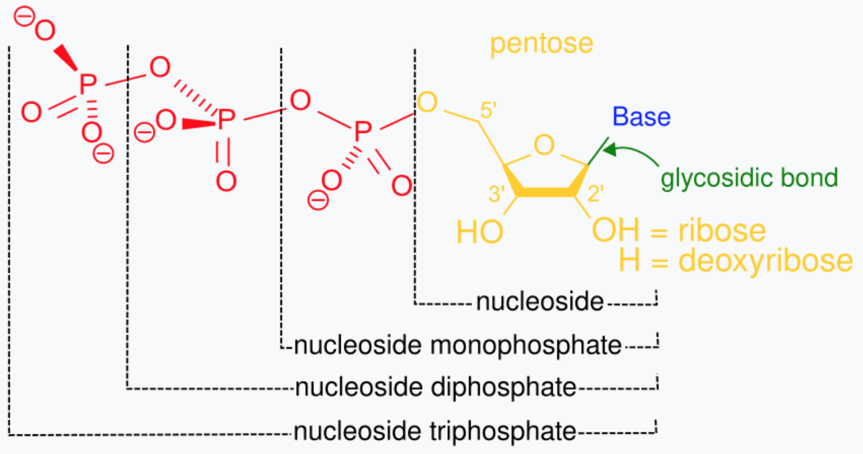
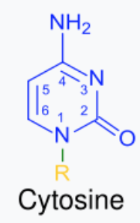
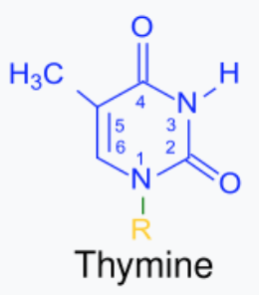
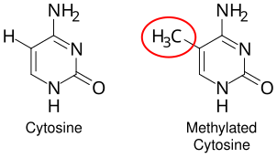
C to T is a common mutation
UV light: C>T mutations in skin cells
Yu et al, 2024, Nature Reviews Genetics 25: 548–562
Wikipedia

Slide 8
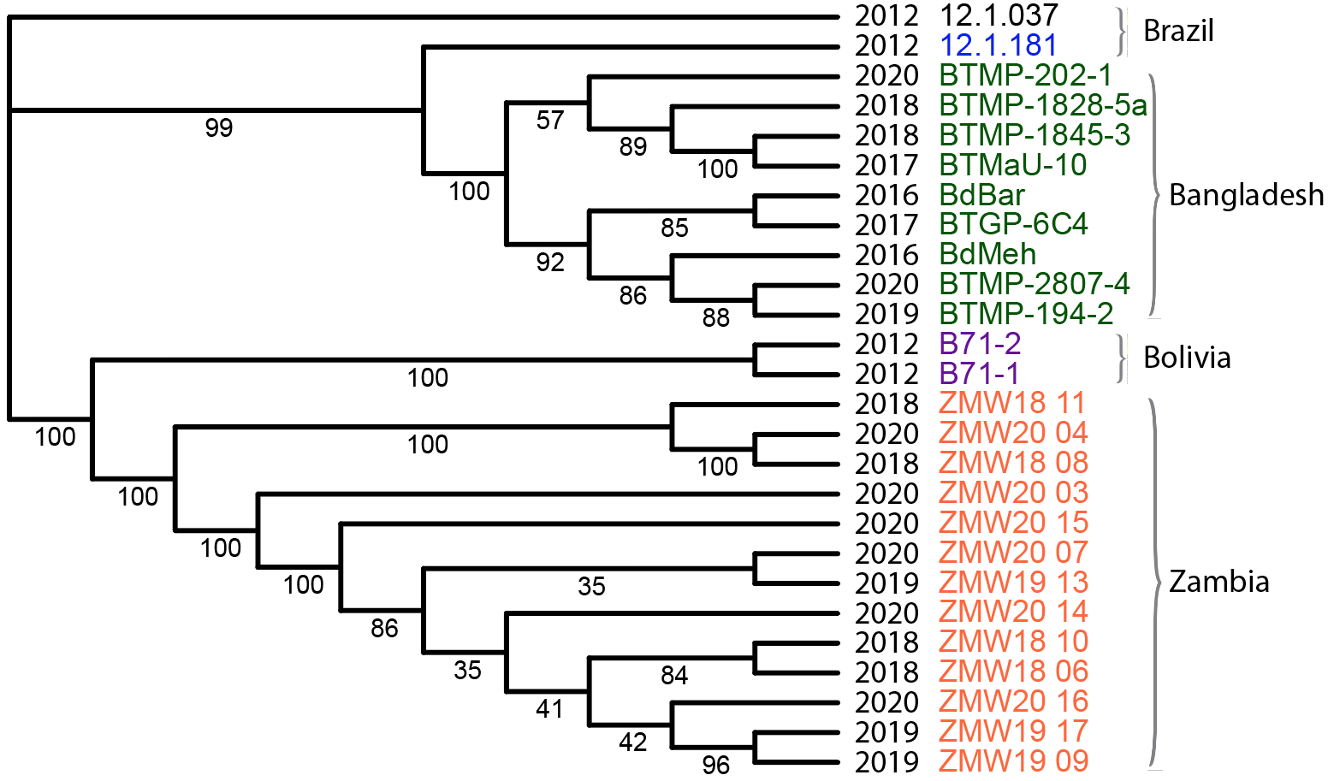
SNP application I: wheat blast fungal movement
SNP tree
2016
2018
Bangladesh
1985
Zambia

Slide 9
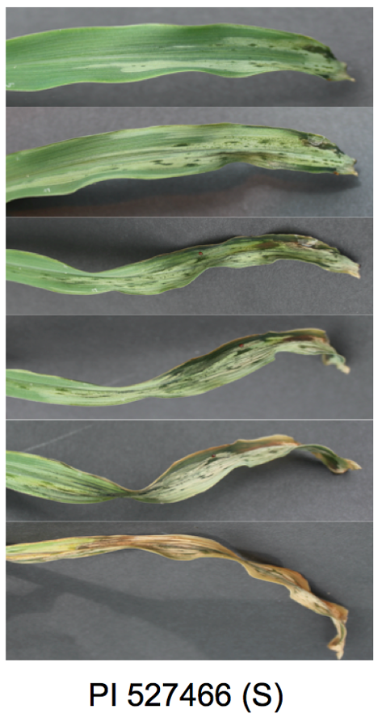
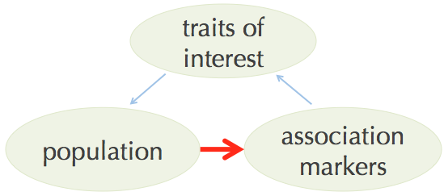
Application II – quantitative genetic analysis
Genetic markers to map the genetic controlling of traits (quality traits, quantitative traits, gene expression, etc.)

Slide 10
Next-Generation Sequencing to generate data for variant discovery
GATCTGCGTCATACGGAAT
GATCTGCGTGATACGGAAT
GATCTGCGTCATACGGAAT
GATCTGCGTGATACGGAAT
GATCTGCGTGATACGGAAT
GATCTGCGTGATACGGAAT
GATCTGCGTCATACGGAAT
GATCTGCGTCATACGGAAT
GATCTGCGTGATACGGAAT
GATCTGCGTCATACGGAAT
--------C/G--------
Heterozygous call
(diploid genome)
Notes:
The revolution of sequencing allows for affordable genotyping.

Slide 11
Approaches for data generation
Whole genome sequencing (WGS): high genome coverage but costly for large genomes
Exome-capture sequencing: target on genic regions
RNA sequencing (RNA-seq): obtain data on genic regions and provide expression information
Genotyping-By-Sequencing (GBS): cost-efficient and high-throughput approach
Skim sequencing: low-depth WGS

Slide 12
Alignment-based SNP discovery
…GATCTGCGTCATACGGAAT… (reference)
GATCTGCGTGATACGGAAT
GATCTGCGTCATACGGAAT
GATCTGCGTGATACGGAAT
GATCTGCGTGATACGGAAT
GATCTGCGTGATACGGAAT
GATCTGCGTCATACGGAAT
GATCTGCGTCATACGGAAT
GATCTGCGTGATACGGAAT
GATCTGCGTCATACGGAAT
--------C/G--------
reads

Slide 13
Alignment-based SNP discovery, cont.
General procedure
Reads cleanup (adaptor, quality trimming, e.g., trimmomatic)
Reads aligned to the reference genome with aligners
1. BWA, Bowtie (DNA-seq reads)
2. HISAT2, STAR, GSNAP, Tophat (RNA-seq reads)
Post-alignment filtering and convert SAM (alignment file) to BAM
SNP calling with software packages: GATK, bcftools …
Use population information or some other criteria to filter SNP sets

Slide 14
Interpretation of the BWA alignment
SAM output:
HWI-ST897:104:C015GACXX:6:1101:12678:20443 163 U00096 1888286 60 64M1D20M = 1888358 170 GCCAACAGCCGCGACTTCCTGTACGCCAGGATGCTGCATGACGACATCTTCAATCTCGTTGGGAAGACGTTAAAAACGGAAACC CCCFFFFFHHFHHJJJJJJJ JHIJHIJIIJIJJJJJIJJJJIJJHHFFFFFFEEEEEEDDDDDDA5,53,8<?CC(50?8BD3? NM:i:2 AS:i:72 XS:i:0 RG:Z:S1
CIGAR: 64M1D20M
NM: edit distance
edit distance is a way to quantify the dissimilarity of two strings (e.g., words) by counting the minimum number of edits (substitution, insertion, and deletion) required to transform one string into the other.
fact -> fit (2)
AACCT -> AAACT (1)
Notes:
2

Slide 15
edit distance
AACCT -> ACCTA (?)
AATCCT -> ATCAT (?)

Slide 16
Polymorphism based on Alignment + reference genome
HWI-ST897:104:C015GACXX:6:1101:12678:20443 163 U00096 1888286 60 64M1D20M = 1888358 170 GCCAACAGCCGCGACTTCCTGTACGCCAGGATGCTGCATGACGACATCTTCAATCTCGTTGGGAAGACGTTAAAAACGGAAACC CCCFFFFFHHFHHJJJJJJJ JHIJHIJIIJIJJJJJIJJJJIJJHHFFFFFFEEEEEEDDDDDDA5,53,8<?CC(50?8BD3? NM:i:2 AS:i:72 XS:i:0 RG:Z:S1
mapping position and CIGAR determine the alignment
Query 1 GCCAACAGCCGCGACTTCCTGTACGCCAGGATGCTGCATGACGACATCTTCAATCTCGTT 60
||||||||||||||||||||||||||||||||||||||||||||||||||||||||||||
Sbjct 1888286 GCCAACAGCCGCGACTTCCTGTACGCCAGGATGCTGCATGACGACATCTTCAATCTCGTT 1888345
Query 61 GGGA-AGACGTTAAAAACGGAAACC 84
|||| ||||||||||| ||||||||
Sbjct 1888346 GGGATAGACGTTAAAACCGGAAACC 1888370

Slide 17
Alignment-based SNP discovery: GATK
The Genome Analysis Toolkit (GATK) is a software package developed at the Broad Institute to primarily focus on variant discovery and genotyping.
Input data: BAM files and reference genome
Code example:
gatk HaplotypeCaller \
-R <your_reference> \
-I <your_bam> \
-glm BOTH
### BOTH = SNP + INDEL
Version v4.3.0.0

Slide 18
Variant output - VCF (Variant Call Format)
isolate 1
isolate 2
https://samtools.github.io/hts-specs/VCFv4.2.pdf
#CHROM | POS | ID | REF | ALT | QUAL | FILTER | INFO | FORMAT | DH10B | MG1655
ref1 | 89089 | . | C | A | 782.76 | . | … | GT:AD:DP:GQ:MLPSAC:MLPSAF:PL | 1:0,18:18:99:1:1.00:781,0 | 0:27,0:27:99:0:0.00:0,1149
ref1 | 89103 | . | G | C | 690.76 | . | … | GT:AD:DP:GQ:MLPSAC:MLPSAF:PL | 1:0,16:16:99:1:1.00:689,0 | 0:29,0:29:99:0:0.00:0,1253
ref1 | 89143 | . | A | G | 448.76 | . | … | GT:AD:DP:GQ:MLPSAC:MLPSAF:PL | 1:0,11:11:99:1:1.00:447,0 | 0:27,0:27:99:0:0.00:0,1165
ref1 | 89145 | . | G | T | 405.76 | . | … | GT:AD:DP:GQ:MLPSAC:MLPSAF:PL | 1:0,10:10:99:1:1.00:404,0 | 0:28,0:28:99:0:0.00:0,1215
GT: AD : DP: GQ: MLPSAC: MLPSAF: PL
1 : 0,18: 18: 99: 1 : 1.00 : 781,0
GT=Genotype (0 or 1)
AD=Allelic depths for the ref and alt alleles
DP=Approximate read depth
GQ=Genotype Quality
MLPSAC=Maximum likelihood expectation (MLE) for the alternate allele count
MLPSAF=Maximum likelihood expectation (MLE) for the alternate allele fraction
PL=Normalized, Phred-scaled scores for likelihoods for genotypes
Prob(0) = 10^(-781/10) = 7.9e-79
Prob(1) = 10^(-0/10) = 1

Slide 19
GATK – variant filtering
GATK can be used to filter SNPs.
gatk SelectVariants \
-R your_reference \
--variant your_vcf \
-select 'DP >= 3.0' \
--restrictAllelesTo BIALLELIC \
--selectTypeToInclude SNP
Filter variants based on the experimental purpose and genetic features

Slide 20
Falsely discovered SNPs
Can you think about what could result in falsely discovered SNPs using alignment-based SNP methods?
Notes:
Sequence errors
Reference errors
Alignment issues

Slide 21
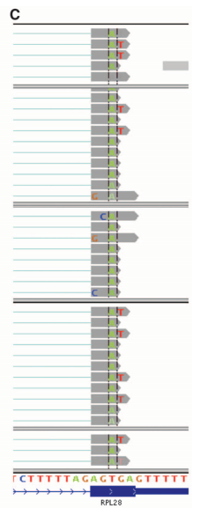

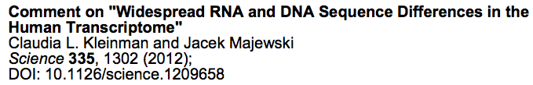
Alignment-based SNP discovery: alignment issues
Misalignments
Genomic structural variation
Highly divergent regions
The misalignments of RNA-Seq data or DNA-Seq data led to this discovery

Slide 22
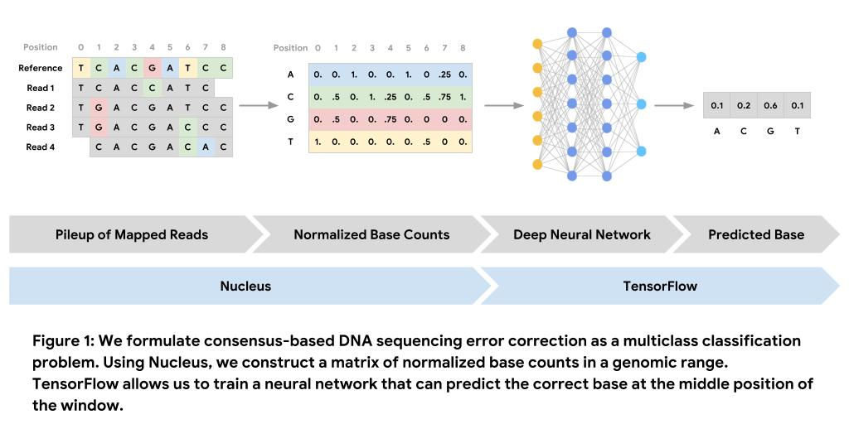
DeepVariant (alignment-based but with deep learning to infer genotypes)
A universal SNP and small-indel variant caller using deep neural networks
Genotypes
Nature Biotechnology 36:983–987(2018)
Notes:
DeepVariant is a deep learning-based variant caller that takes aligned reads (in BAM or CRAM format), produces pileup image tensors from them, classifies each tensor using a convolutional neural network, and finally reports the results in a standard VCF or gVCF file.

Slide 23
Outline
Overview of genomic variants
Data for variant discovery
Bioinformatics of variant discovery
Annotation of genomic variants

Slide 24
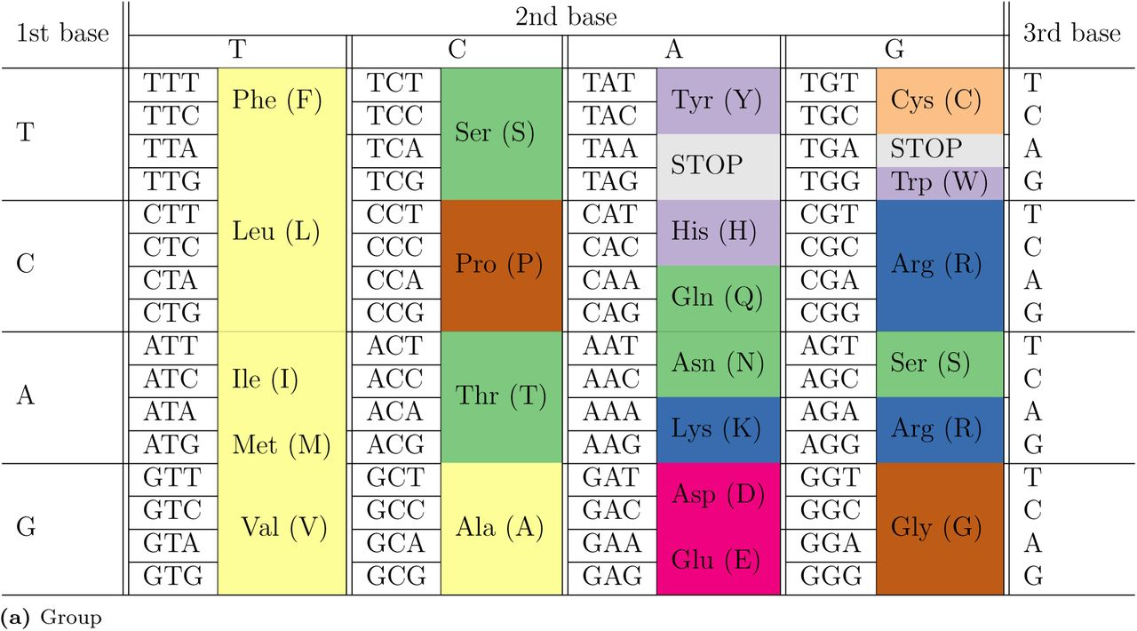
Mutations in coding sequences
Gene coding regions
Synonymous: changes that do not alter
the encoded amino acid
Non-synonymous
Missense: changes that alter encoded amino acid
Nonsense: changes that produce a stop codon from an amino acid codon, resulting in a shortened protein
Frameshift (caused by insertion/deletion)
Splicing sites
Of an intron, a donor site (5' end of the intron) and an acceptor site (3' end of the intron) are required for splicing.
Notes:
What term is used for a mutation occurring on a stop codon sequence?

Slide 25
Variant annotation - SnpEff
SnpEff is a variant annotation and effect prediction tool. It annotates and predicts the effects of variants on genes.
Input data:
Genome annotation database
Variant data: VCF file
Running:
java -jar snpEff.jar GRCh37.75 my.vcf
Cingolani P, et al., DM. Fly (Austin). 2012 Apr-Jun;6(2):80-92.

Slide 26
Detailed effect list from SnpEff
Effect | Note
INTERGENIC | The variant is in an intergenic region
UPSTREAM | Upstream of a gene (default length: 5K bases)
UTR_5_PRIME | Variant hits 5′UTR region
UTR_5_DELETED | The variant deletes an exon which is in the 5′UTR of the transcript
START_GAINED | A variant in 5′UTR region produces a three base sequence that can be a START codon.
SPLICE_SITE_ACCEPTOR | The variant hits a splice acceptor site (defined as two bases before exon start, except for the first exon).
SPLICE_SITE_DONOR | The variant hits a Splice donor site (defined as two bases after coding exon end, except for the last exon).
START_LOST | Variant causes start codon to be mutated into a non-start codon.
SYNONYMOUS_START | Variant causes start codon to be mutated into another start codon.
CDS | The variant hits a CDS.
GENE | The variant hits a gene.
TRANSCRIPT | The variant hits a transcript.
EXON | The vairant hist an exon.
EXON_DELETED | A deletion removes the whole exon.
NON_SYNONYMOUS_CODING | Variant causes a codon that produces a different amino acid
SYNONYMOUS_CODING | Variant causes a codon that produces the same amino acid
FRAME_SHIFT | Insertion or deletion causes a frame shift
CODON_CHANGE | One or many codons are changed
CODON_INSERTION | One or many codons are inserted
CODON_CHANGE_PLUS_CODON_INSERTION | One codon is changed and one or many codons are inserted
CODON_DELETION | One or many codons are deleted
CODON_CHANGE_PLUS_CODON_DELETION | One codon is changed and one or more codons are deleted
STOP_GAINED | Variant causes a STOP codon
SYNONYMOUS_STOP | Variant causes stop codon to be mutated into another stop codon.
STOP_LOST | Variant causes stop codon to be mutated into a non-stop codon
INTRON | Variant hist and intron. Technically, hits no exon in the transcript.
UTR_3_PRIME | Variant hits 3′UTR region
UTR_3_DELETED | The variant deletes an exon which is in the 3′UTR of the transcript
DOWNSTREAM | Downstream of a gene (default length: 5K bases)
INTRON_CONSERVED | The variant is in a highly conserved intronic region
INTERGENIC_CONSERVED | The variant is in a highly conserved intergenic region
Missense

Slide 27
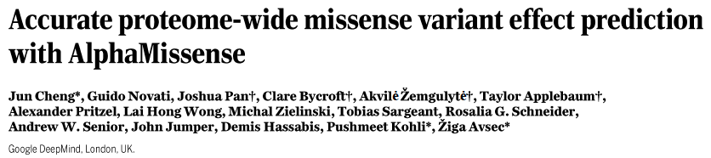
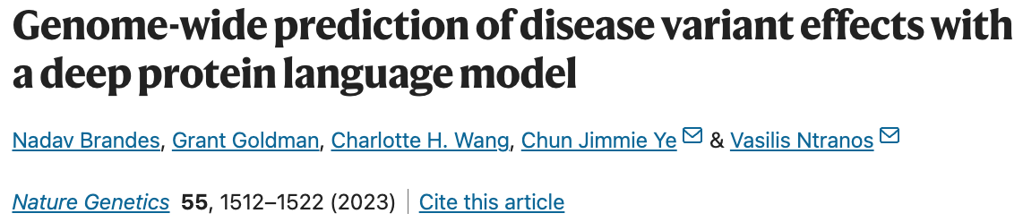
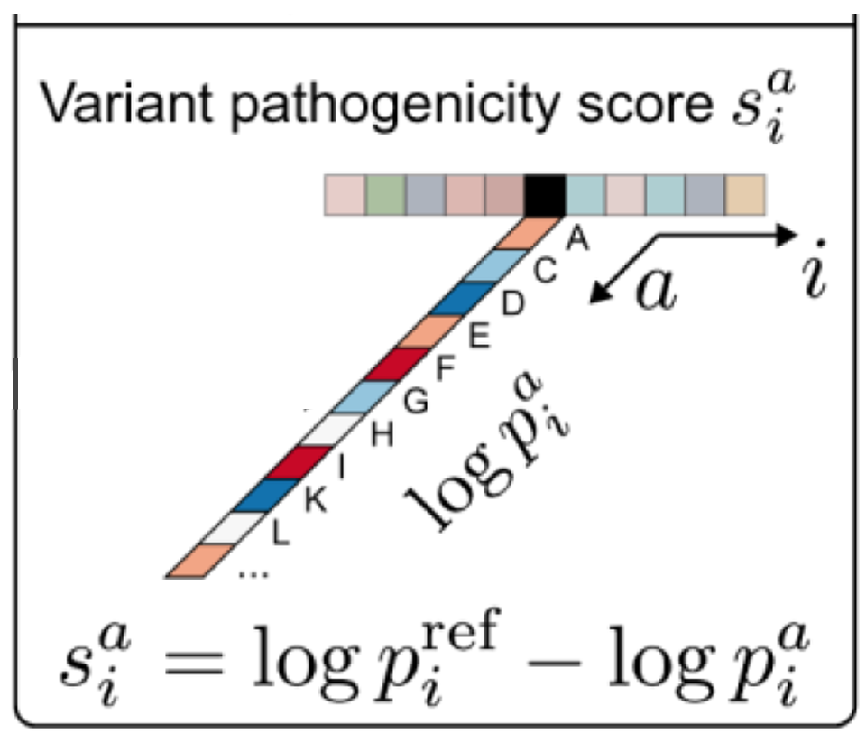
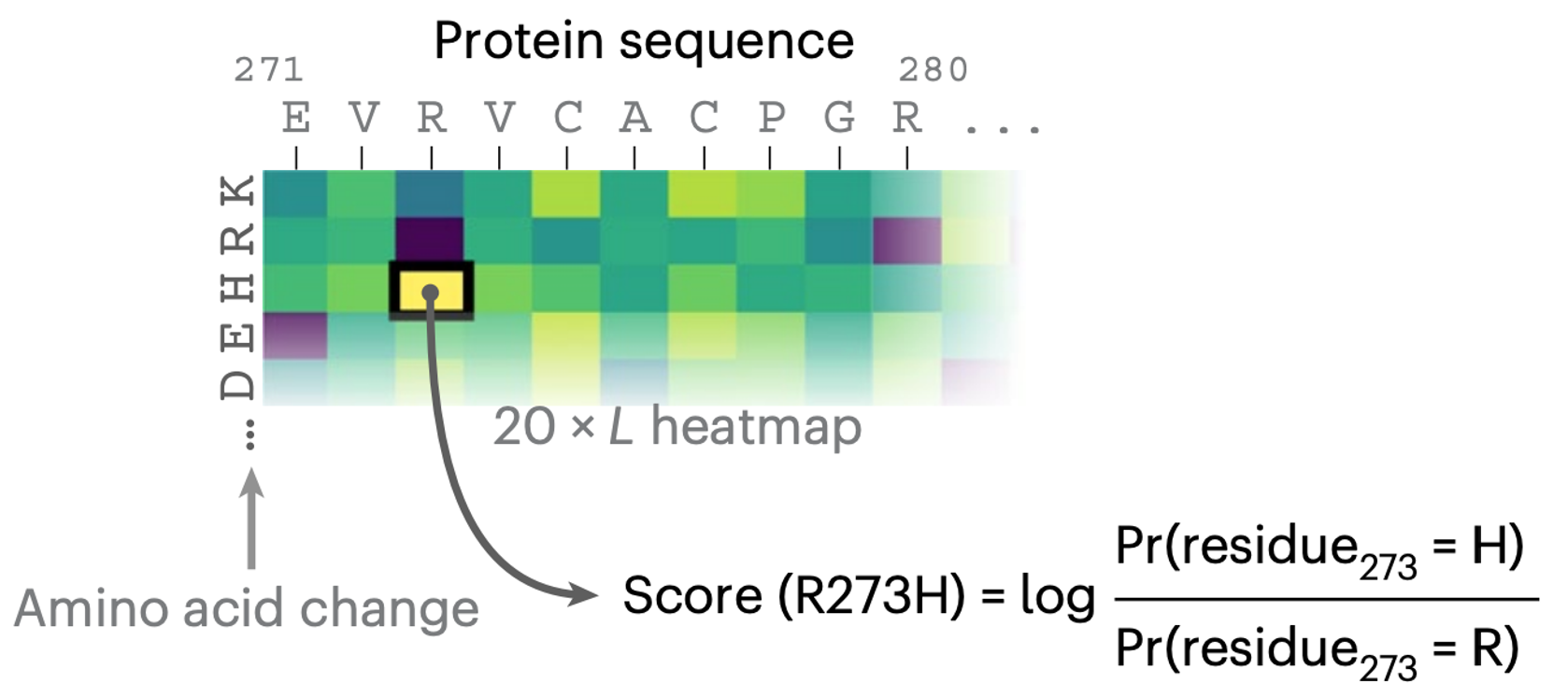
AI in predicting effects of missense mutations
Alphamissense (Google)
ESM1b (Meta)

Slide 28
Summary
The strategy to generate data for SNP discovery is dependent on experimental purposes, genetic features of the population, and budgets.
A standard approach for SNP discovery is through mapping reads to reference sequences, thereby identifying variants between reads and reference. The most popular method is GATK.

